Slide 1


Slide 2
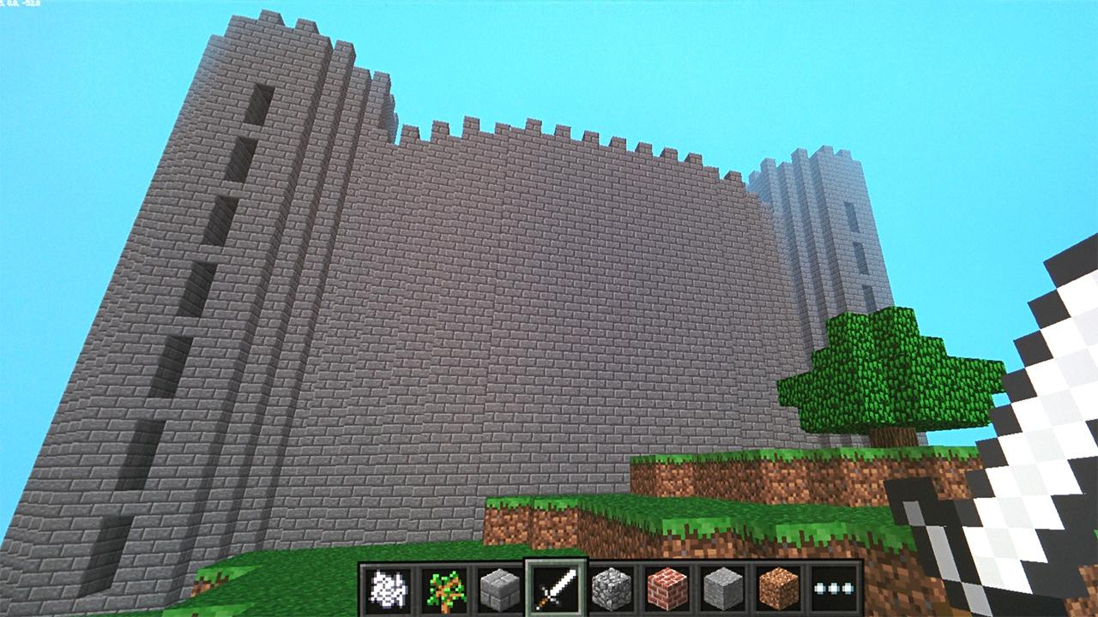

Slide 3
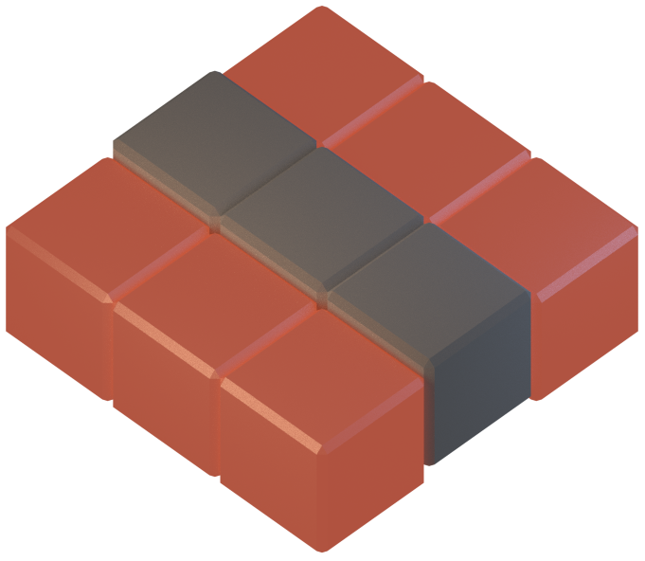
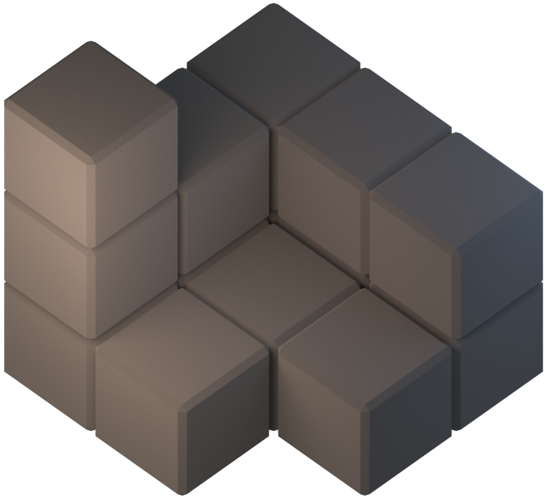

Slide 4
The Rules
The Lava Crossing script and tunneling script must be separate files
stop the first script before starting the second
If you fall in the lava you must restart from the start point
You must stay within the insides of the castle when tunneling
No teleporting, no flying. No use of fixed coordinates in scripts

Slide 5
Hints
The midas touch script will work for the lava moat, but try expanding the area it affects to prevent you falling in.
Be careful how you tunnel, digging in front of you will make it difficult to climb upwards

